Slide 1

Eye-Tracking Virtual Mouse
By
BE A-15 Vishwesh Chavan
BE A- 37 Rushikesh Jadhav
BE A-38 Shreyas Jadhav
under the guidance of
Ms. Pooja Patil
Department of Computer Engineering
Pillai HOC College of Engineering and Technology, Rasayani
University of Mumbai, Mumbai
A.Y 2023-2024

Slide 2
CONTENT
Introduction
Motivation
Literature review
Limitations of existing system
Objectives
Problems Statement
System Architecture
Cost estimation
Gantt chart
Result analysis
Conclusion
Reference

Slide 3
Introduction
Eye-Tracking Virtual Mouse, We are here to explore how cutting-edge assistive technology is empowering individuals with limited mobility, unlocking new possibilities, and enhancing accessibility like never before. Eye-Tracking virtual mouse is a technology that enables us to operate or control the cursor on our screen virtually with the detection of eye and face movements. As the movement of face or eyes detected then the cursor follows the direction. For click function we just need to blink eyes.

Slide 4
Motivation
The motivation behind an eye-tracking virtual mouse project stems from the desire to provide an alternative or supplementary means of computer interaction for individuals who may have difficulty using traditional input devices such as a physical mouse or keyboard. This technology is particularly valuable for people with disabilities, including those with motor impairments, spinal cord injuries, or conditions like ALS (Amyotrophic Lateral Sclerosis), which limit their ability to use conventional input methods.
Individuals with mobility impairments, such as paralysis or limb amputations, may have difficulty using traditional input devices like a mouse or keyboard. Eye-tracking technology allows them to control the cursor and perform various tasks using their eye movements, providing a more accessible means of computer interaction.

Slide 5
Literature review
Title | Authors | Publication Year | Summary
Eye Tracking in Virtual Environments: A Review of Recent Advances | Smith, J. & Johnson, A. | 2023 | advancements in eye tracking technology and its applications in virtual environments, including virtual mouse control.
Enhancing Virtual Reality Navigation with Eye-Tracking-Based Virtual Mouse Control | Kim, S. et al. | 2022 | he study e how eye tracking can improve virtual reality navigation by implementing a virtual mouse controlled using eye movements
Evaluation of Eye-Tracking-Based Virtual Mouse for Disabled Users in VR | Chen, Q. & Wang, L. | 2021 | This research evaluates the usability of an eye-tracking-based virtual mouse for individuals with disabilities in virtual reality settings.

Slide 6
Objectives
Enhancing Accessibility
Improving Communication
Hands-Free Interaction

Slide 7
Problem Statement
The traditional computer mouse has been a fundamental input device for human-computer interaction (HCI) for decades. However, it poses limitations for individuals with motor impairments or those engaged in hands-busy tasks like surgeons, gamers, and artists. To address these challenges and enhance HCI, the development of an Eye-Tracking Virtual Mouse (ETVM) system is imperative.
Develop a system that enables users to control and interact with a computer or digital device using their eye movements as an input method, effectively replacing the traditional mouse and keyboard input. The goal is to create a reliable and user-friendly eye tracking virtual mouse system that enhances accessibility, convenience, and efficiency for individuals with physical disabilities, as well as for general computer users who seek a novel and intuitive way to interact with their devices.

Slide 8
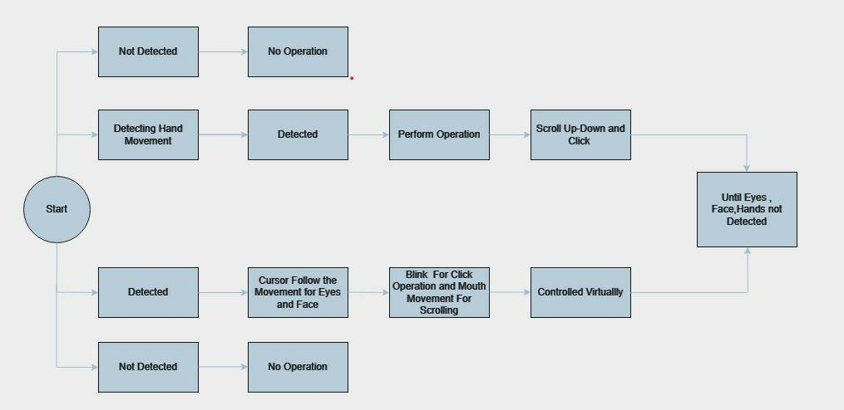
System Architecture

Slide 9
Cost Estimation
Requirement | Estimation
Development time | 192 hrs
Manpower Required | 192/3=64 hrs per person

Slide 10
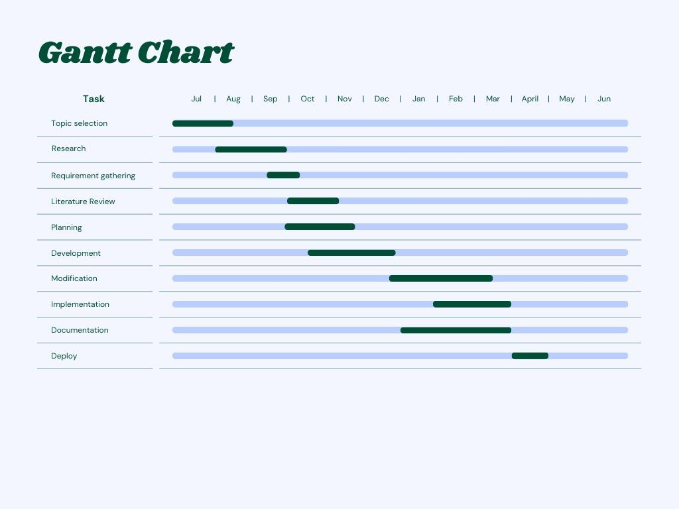
Gantt chart

Slide 11
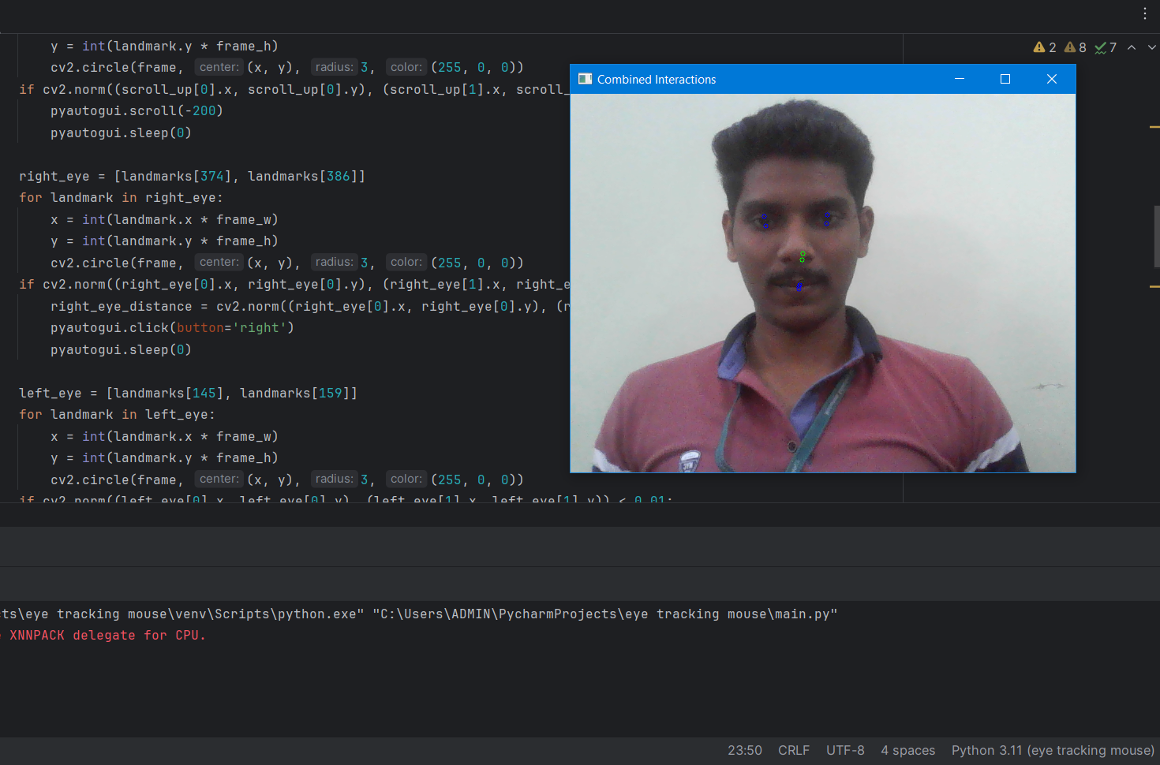
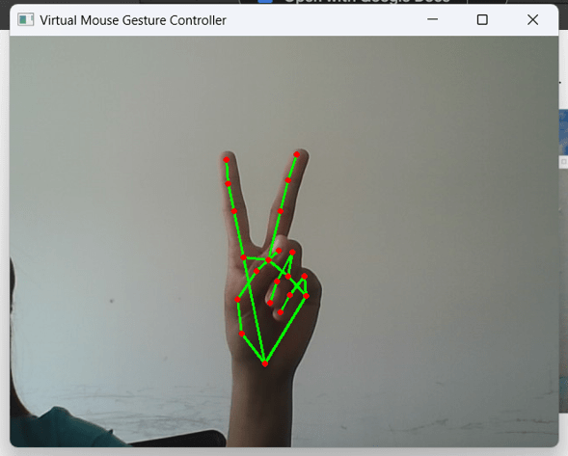
Result Analysis

Slide 12
Conclusion
In conclusion, the eye-tracking virtual mouse project has demonstrated promising results in providing an alternative input method for individuals with physical disabilities or limitations. Our findings suggest that eye-tracking technology can offer precise and intuitive control in virtual environments, enhancing accessibility and user experience.Future research should focus on optimizing the technology for real-world applications and exploring its potential in diverse contexts, including assistive technologies, gaming, and human-computer interaction. Overall, this project marks a significant step towards leveraging eye-tracking technology to empower individuals with disabilities and improve the inclusivity of digital platforms.

Slide 13
References
Anderson, C. W. (2007). Perspectives on science learning. In S. K. Abell & N. G. Lederman (Eds.), Handbook of research on science education (pp. 3–30). NY: Routledge.
Ariasi, N., & Mason, L. (2011). Uncovering the effect of text structure in learning from a science text: An eye-tracking study. Instructional Science, 39, 581–601.
Arnold, J. E., Eisenband, J. G., Brown-Schmidt, S., & Trueswell, J. C. (2000). The rapid use of gender information: Evidence of the time course of pronoun resolution from eye tracking. Cognition, 76, B13–B26.
Balslev, T., Jarodzka, H., Holmqvist, K., de Grave, W., Muijtjens, A. M., Eika, B., van Merriënboer, J., & Scherpbier, A. J. (2012). Visual expertise in paediatric neurology. European Paediatric Neurology Society, 16, 161–166.

Slide 14
THANK YOU!!!

